Slide 1

Weather station
Patrick Bongala,adam byrne,Ciaran ryan, daryl sweeney

Slide 2
Weather station setup
PT100 Temperature Sensor
Senses temperature by changing resistance with temperature.(100Ω @ 0°)
Wheatstone Bridge
Better alternative to measure resistance change and converts into a small voltage.
Differential Amplifier
Amplifies the small voltage from the Wheatstone bridge.
Arduino
Reads the amplified signal using its Analog to digital converter.
Processes the data to calculate temperature.
Rescaling
Converts the voltage signal into a temperature value using calibration.

Slide 3
Temperature Sensor Selection and Justification
PT100 Temperature Sensor
We Chose the PT100 temperature sensor because it is made of platinum, which is one of the three materials whose resistance changes in a linear fashion with temperature. This linear relationship between resistance and temperature allows for accurate and predictable temperature measurements, making it ideal for our weather station

Slide 4
How Temperature Sensor Circuit Works!
Basically, the circuit compares the differential voltage of the PT100 sensor on one voltage divider minus the voltage of the PT100 at 0° Celsius on the other voltage divider of the Wheatstone bridge.
Each voltage goes into an Operational amplifier
The difference is the voltage out...
This goes into an analogue pin in the Arduino.

Slide 5
How Temperature Sensor Circuit Works!
It then gets converted using analogue to digital conversion.
The code then converts it into a temperature reading...

Slide 6
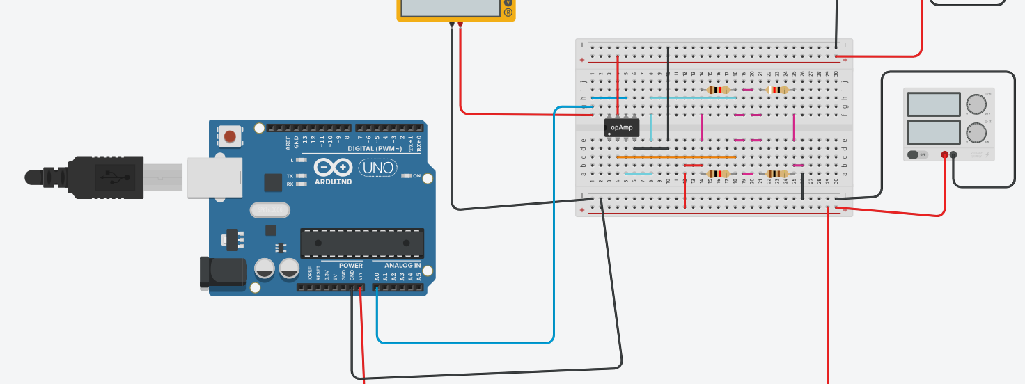
Temperature sensor Version 1(optional)
Using a buffer amplifier with a gain of 1

Slide 7
Temperature Sensor V.1
The operational amplifier has no Rf or Ri resistors
This gives no gain in the op-amp or a gain of 1
The op-amp only functions as a differencing amplifier with no gain

Slide 8
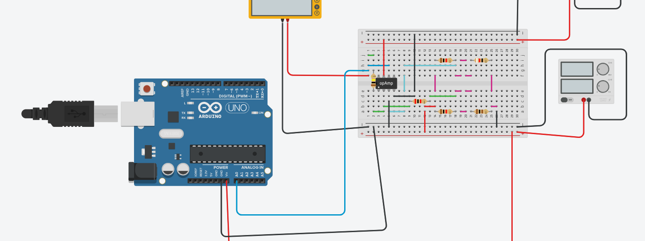
Temperature Sensor Version 1.1(more ideal)
Using a Rf and Ri resistor for a gain.. In this case a gain of 50

Slide 9
Temperature Sensor V1.1
Using a gain in the operational amplifier is better.
The gain is 50 and can be adjusted
The Wheatstone bridge is a separate element of the circuit.
The difference voltages only serve as inputs
The op-amp serves as an inverting amplifier

Slide 10
Two prototype codes were written.
One based on the First order equation for temperature given.
The second was based on the second order equation for temperature – giving more accuracy
It is a code to build further functioning and effectiveness
It is unknown to the team how to tune the op-amp if we need too but an offset option was added to the code.

Slide 11
Possible additions to device pending permission are...
If the Arduino nano chip was to accomodate for it?
A possible SD card unit/SD card for memory
A possible clock chip which could be coded to keep time and date, and especially temperature or weather statistic we want to collect with memory
Maybe a digital screen- but its unknown if we'll need more power

Slide 12
Possible additions to device pending permission are...
Leaving the weather station powered remotely would be possible then it would just a matter of logging in and graphing the information on excel, matlab or another system software that can give a good idea of statistics.
Possibly a predictive algorithm could be developed from the data to give localised forecasts or other statistical ideas or developments

Slide 13
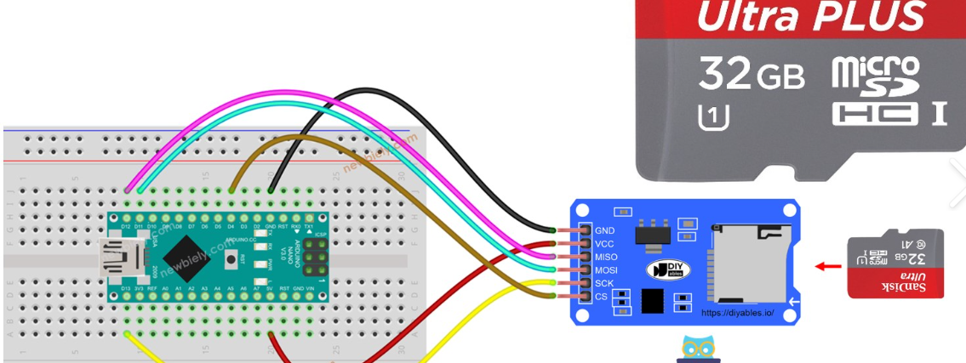
Example of SD unit and card
Optionally could be added for memory

Slide 14
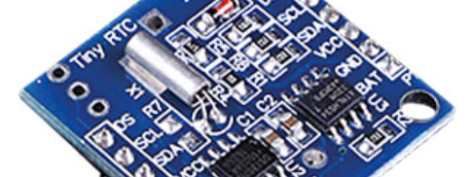
An example 24C3232K clock chip

Slide 15
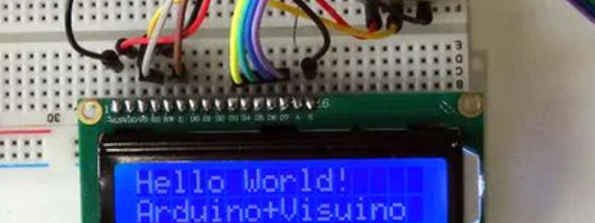
An example 2 x 16 LCD display

Slide 16
Citing
www.instructables.com
www.newbiely.com
www.reichelt.com
www.tinkercad.com

